Slide 1

High Quality Code and Refactoring
Code Correctness, Readability, Maintainability, Testability,
When and How to Refactor
SoftUni Team
Technical Trainers
Software University
https://softuni.bg

Slide 2
Table of Contents
High-Quality Code
What is High-Quality Code?
Identifier Naming and Code Formatting
Comments and Code Documentation
Organizing Data Correctly
Use of Variables and Expressions, Control Flow Statements, Constants
High-Quality Methods and Classes
Refactoring
Refactoring Principles, Process and Tips, Patterns and Levels

Slide 3
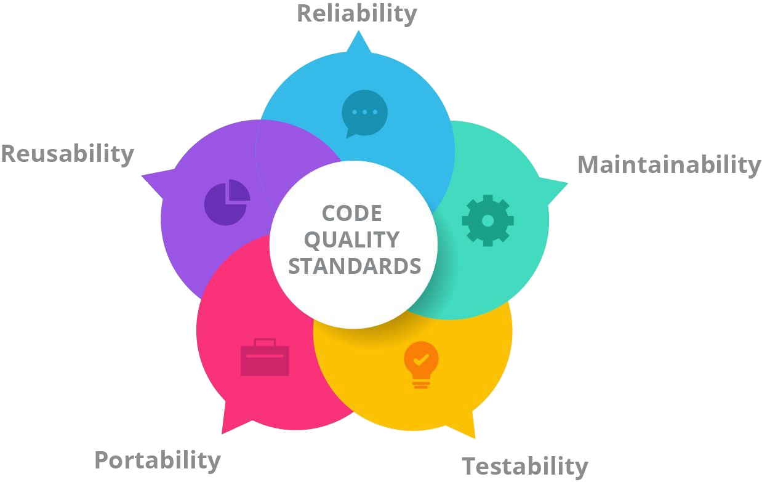
What is High-Quality Code?
Correctness, Readability, Maintainability, Testability

Slide 4

What is High-Quality Programming Code
High-quality programming code:
Easy to read and understand
Easy to modify and maintain
Correct behavior in all cases
Well tested
Well developed architecture and design
Well documented
Self-documenting code
Well formatted

Slide 5

What is High-Quality Programming Code (2)
High-quality programming code has:
Strong cohesion at all levels: modules, classes, methods, etc.
Single unit is responsible for single task
Loose coupling between modules, classes, methods, etc.
Units are independent one of another
Good formatting
Good names for classes, methods, variables, etc.
Self-documenting code style

Slide 6

Why Quality Is Important?
What does this code do? Does it do its job correctly? Does it contain any errors?
Well, it is hard to know, as it is:
Not easy to read
Badly formatted
Hard to understand
static void Main()
{
int value=010, i=5, w;
switch(value){case 10:w=5;Console.WriteLine(w);break;case 9:i=0;break;
case 8:Console.WriteLine("8 ");break;
default:Console.WriteLine("def ");{
Console.WriteLine("hoho "); }
for (int k = 0; k < i; k++, Console.WriteLine(k - 'f'));break;} { Console.WriteLine("loop!"); }
}
Not testable
Not documented

Slide 7
Why Quality Is Important? (2)
Now the code is formatted, but is still unclear
If all the code is written in this way, it would be impossible to create big and serious software projects
So, good quality code can be considered as an essential property of software
static void Main()
{
int value = 010, i = 5, w;
switch (value)
{
case 10: w = 5; Console.WriteLine(w); break;
case 9: i = 0; break;
case 8: Console.WriteLine("8 "); break;
default:
Console.WriteLine("def ");
Console.WriteLine("hoho ");
for (int k = 0; k < i; k++,
Console.WriteLine(k - 'f')) ;
break;
}
Console.WriteLine("loop!");
}

Slide 8

Key Characteristics of High-Quality Code
Correct behavior
Conforming to the requirements
Stable, no hangs, no crashes
Bug free – works as expected
Correct response to incorrect usage
Readable – easy to read
Understandable – self-documenting
Maintainable – easy to modify
static void Main()
{
int value = 10;
int row = 5;
int column = 0;
switch (value)
{
case 10:
column = 5;
Console.WriteLine(column);
break;
case 9:
row = 0;
break;
case 8:
Console.WriteLine("8 ");
break; …
}
Console.WriteLine("loop!");
}
Here is what the previous code should look like if we format it correctly

Slide 9

Key Characteristics of High-Quality Code (2)
Good identifiers names (for variables, constants, methods, etc.)
High-quality classes, interfaces and class hierarchies
Good abstraction, encapsulation, inheritance and polymorphism; simplicity, reusability, minimal complexity
High-quality methods
Reduced complexity, improved readability, strong cohesion, loose coupling
Variables, data, expressions and constants
Minimal variable scope, span, live time, simple expressions, correctly used constants, correctly organized data

Slide 10

Identifier Naming and Code Formatting
Naming Variables, Methods, Constants, Classes, Etc.

Slide 11
General Naming Guidelines
Always use English – all software developers speak English
Avoid abbreviations and hard-to-pronounce names
Example: scriptsCount, not scrpCnt
Example: dateTimeBulgarianRegExPattern, not dtbgRegExPtrn
Always prefer meaningful names
Whether a name is meaningful or not depends on its context (enclosing type)
Use consistent naming in the entire project
The name should be as long as required

Slide 12
Naming Classes and Structures
For classes and structures use the following formats:
[Noun]
Examples: Student, FileSystem, BinaryTreeNode
Incorrect examples: Move, FindUsers, Fast, Optimize
For interfaces use the following formats:
'I' + [Verb] + 'able'
Examples: IEnumerable, IFormattable, IDataReader
Incorrect examples: List, iFindUsers, IMemoryOptimize
[Adjective] + [Noun]
'I' + [Noun], 'I' + [Adjective] + [Noun]

Slide 13
Naming Special Classes
Use this class suffix
Attributes
WebServiceAttribute, not WebService
Collection classes
StringsCollection, not ListOfStrings
Exceptions
FileNotFoundException, not FileNotFoundError
Delegate classes
DownloadFinishedDelegate, not WakeUpNotification
ClickedEventHandler, not ClickedButton

Slide 14
Naming Methods
Use PascalCase with the following format:
[Verb], [Verb] + [Noun] or [Verb] + [Adjective] + [Noun]
Examples: Show, LoadSettingsFile
Incorrect examples: Student, Generator, counter
Methods returning values should describe the returned value
Examples: ConvertMetersToInches, not MetersInches or Convert or ConvertUnit

Slide 15
Naming Method Parameters and Variables
Method parameters names
Preferred form: [Noun] or [Adjective] + [Noun]
Examples: firstName, report
Incorrect examples: p, p1, p2, populate
Variable names
Should be in camelCase
Preferred form: [Noun] or [Adjective] + [Noun]
Should explain the purpose of the variable
Examples: firstName, report, config, usersList
Incorrect examples: foo, bar, p, p1, p2, populate

Slide 16
Naming Namespaces and Project Folders
Naming namespace
Use PascalCase with the following format:
Company.Product.Component.…
Example: Microsoft.WinControls.GridView
Incorrect examples: Microsoft_WinControlsGridView
Naming project folders
Project folders' names should follow the project namespaces
Examples: System.Collections.Generic…
Incorrect examples: generic.src, system_collections_generic

Slide 17
Naming Files and Applications
Naming files
Files with source code should have names matching their content
Example: Constants.cs, CryptographyAlgorithms.cs
Incorrect examples: Program.cs, SourceCode.cs , Page1.aspx
Naming applications
Use PascalCase with the following format:
[Noun] or [Adjective] + [Noun]
Examples: BlogEngine, NewsAggregatorService
Incorrect examples: ConsoleApplication4, WebSite2, zadacha_14, online_shop_temp2
The file containing a class Student should be named Student.cs

Slide 18

Identifier Naming
Live Demo

Slide 19
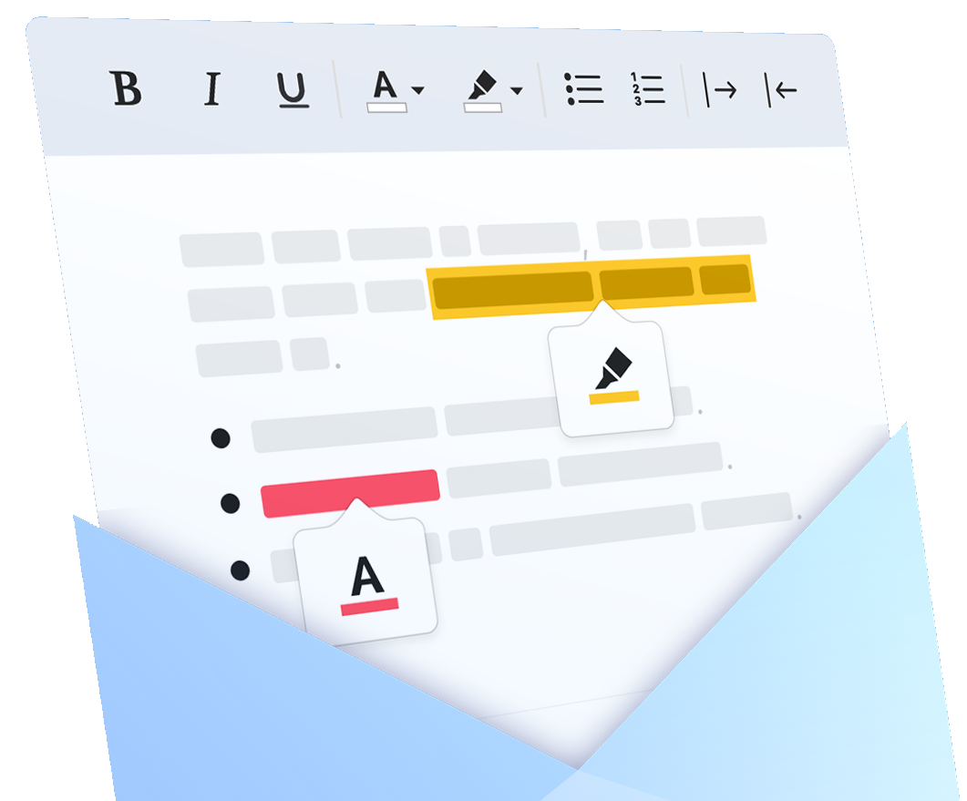
Code Formatting
Formatting the Source Code Correctly

Slide 20

Code Formatting
Formatting has two objectives:
To improve code readability
To improve code maintainability
Formatting should follow the logical structure of the program so that the logical understanding is supported
Any formatting style that follows the above principle is good
Any other formatting is not good

Slide 21
Formatting Types
public class Dog
{
public const string Species = "…";
private int age;
public Dog(string name, int age)
{
this.Name = name;
this.age = age;
}
public string Name { get; set; }
public void Bark()
{
...
}
}
Formatting classes / structures / interfaces / enumerations
Indent the class body with a single [Tab]
By member type: constants, delegates, inner types, fields, constructors, properties, methods
By visibility: static members, public members, protected members, internal members, private members
Static variable
Private field
Constructor
Property
Method

Slide 22
Formatting Conditional Statements and Loops
Formatting conditional statements and loops
Always use { } block after if / for / while, even when a single operator follows
Indent the block body after if / for / while
Always put a new line after an if / for / while block
Always put the { on the next line
Never indent with more than one [Tab]
The { should be on the next line
for (int i=0; i<10; i++) {
Console.WriteLine("i={0}", i);
}
The { and } are missing
for (int i=0; i<10; i++) Console.WriteLine("i={0}",i);
for (int i = 0; i < 10; i++)
{
Console.WriteLine("i = {0}", i);
}

Slide 23
Formatting Methods
Methods should be indented with a single [Tab] from the class body
Methods body should be indented with a single [Tab] as well
Brackets in the method declarations should be formatted as follows:
Don't use spaces between the brackets:
public class IndentationExample
{
private int Zero()
{
return 0;
}
}
The method body is also indented
The entire method is indented with a single [Tab]
private static ulong CalculateFactorial(uint num)
private static ulong CalculateFactorial ( uint num )
private static ulong CalculateFactorial (uint num)

Slide 24
Formatting Methods (2)
Separate method parameters by a comma followed by a space
Use an empty line to separate logically related sequences of lines:
private void RegisterUser(string username ,string password)
Don't put a space before the comma
private void RegisterUser(string username, string password)
private List<Report> PrepareReports()
{
List<Report> reports = new List<Report>();
// Create incomes reports
Report incomesSalesReport = PrepareIncomesSalesReport();
reports.Add(incomesSalesReport);
Report incomesSupportReport = PrepareIncomesSupportReport();
reports.Add(incomesSupportReport);
return reports;
}
Empty line
Empty line

Slide 25

Code Formatting
Live Demo

Slide 26

Comments and Code Documentation
The Concept of Self-Documenting Code

Slide 27
Effective Comments
Effective comments do not repeat the code
They explain it at a higher level and reveal non-obvious details
The best software documentation is the source code itself – keep it clean and readable!
Self-documenting code is self-explainable and does not need comments
Simple design, small well-named methods, strong cohesion and loose coupling, simple logic, good variable names, good formatting, …

Slide 28
Badly Documented Code – Example
public static List<int> FndPrimes(int start, int end)
{
List<int> primesList = new List<int>(); // Create new list of integers
// Perform a loop from start to end
for (int num = start; num <= end; num++)
{
bool prime = true; // Declare boolean variable, initially true
// Perform loop from 2 to sqrt(num)
for (int div = 2; div <= Math.Sqrt(num); div++)
{
// Check if div divides num with no remainder
if (num % div == 0)
{
// We found a divider -> the number is not prime
prime = false;
break; // Exit from the loop }
…
}
}
}
All comments explain obvious details. They repeat the code
All comments explain obvious details. They repeat the code

Slide 29
Self-Documenting Code – Example
public static List<int> FindPrimes(int start, int end)
{
List<int> primesList = new List<int>();
for (int num = start; num <= end; num++)
{
bool isPrime = IsPrime(num);
if (isPrime)
{
primesList.Add(num);
}
}
return primesList;
}
Good code needs no comments. It explains itself.

Slide 30
Self-Documenting Code – Example (2)
private static bool IsPrime(int num)
{
bool isPrime = true;
int maxDivider = (int) Math.Sqrt(num);
for (int div = 2; div <= maxDivider; div++)
{
if (num % div == 0)
{
// We found a divider -> the number is not prime
isPrime = false;
break;
}
}
return isPrime;
}
Good methods have good names and are easy to read and understand
This comment explains non-obvious details. It does not repeat the code

Slide 31

Organizing Data Correctly
Variables and Expressions, Control Statements, Constants

Slide 32
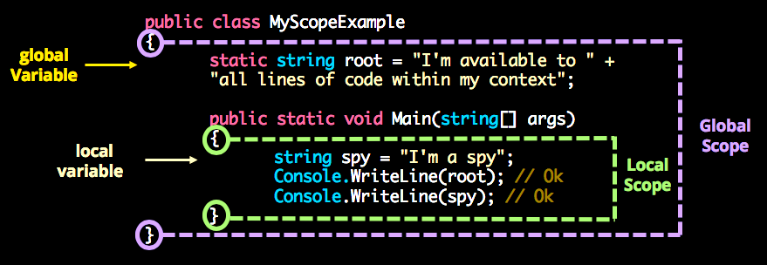
Variables Scope And Visibility
Scope – a way of thinking about a variable's accessibility
Global (static), member variable, local
The scope is often combined with visibility
Variable visibility is explicitly set restriction regarding the access to the variable
Always try to reduce the variables scope and visibility
internal
public
private
protected

Slide 33
Variables Scope And Visibility
This variable goes out of the scope
Better pass the variable as an argument
public class Globals
{
public static int state = 0;
}
public class ConsolePrinter
{
public static void Print()
{
if (Globals.state == 0)
Console.WriteLine("Hello.");
else
Console.WriteLine("…")
}
}
public class ConsolePrinter
{
public static void Print(int state)
{
if (state == 0)
Console.WriteLine("Hello.");
else
Console.WriteLine("…")
}
}

Slide 34
Variable Span and Lifetime
Variable span == the average number of lines of code (LOC) between variable usages
Variable lifetime == the number of lines of code (LOC) between the first and the last variable usage in a block
1 a = 1;
2 b = 1;
3 c = 1;
4 b = a + 1;
5 b = b / c;
One line between the first reference to b and the second
span = 1
No lines between the second reference to b and the third
span = 0
The average span for b is (1 + 0) / 2 = 0.5
25 recordIndex = 0;
26 while (recordIndex < recordCount)
27 { ...
28 recordIndex = recordIndex + 1;
...
recordIndex (line 28 - line 25 + 1) = 4
The average lifetime for recordIndex is 4 / 1 = 4

Slide 35
Variable Span and Lifetime (2)
Variable span and lifetime should be kept as low as possible
Rules for minimizing span and lifetime:
Define variables at their first usage
Initialize variables just before their first usage
Try to keep together blocks of code using the same variable
Initialize the count variable before first use
int count = 0;
while (count != 10)
{
count++;
}
Console.WriteLine(count);
Keeping together the block of code using the same variable

Slide 36
Large and Reduced Variable Span and Lifetime
int count;
int[] numbers = new int[100];
for (int i = 0; i < numbers.Length; i++)
{
numbers[i] = i;
}
count = 0;
for (int i = 0; i < numbers.Length / 2; i++)
{
numbers[i] = numbers[i] * numbers[i];
}
for (int i = 0; i < numbers.Length; i++)
{
if (numbers[i] % 3 == 0)
{
count++;
}
}
Console.WriteLine(count);
int[] numbers = new int[100];
for (int i = 0; i < numbers.Length; i++)
{
numbers[i] = i;
}
for (int i = 0; i < numbers.Length / 2; i++)
{
numbers[i] = numbers[i] * numbers[i];
}
int count = 0;
for (int i = 0; i < numbers.Length; i++)
{
if (numbers[i] % 3 == 0)
{
count++;
}
}
Console.WriteLine(count);
Lifetime = 19
Lifetime = 9
Span =
(4+2) / 3 = 2
Span =
(5+8+2) / 3 = 5

Slide 37
Never Use Complex Expressions in the Code!
What shall we do if we get at this line IndexOutOfRangeException?
for (int i = 0; i < xCoords.Length; i++)
for (int j = 0; j < yCoords.Length; j++)
matrix[i][j] =
matrix[xCoords[FindMax(i) + 1]][yCoords[FindMin(j) - 1]] *
matrix[yCoords[FindMax(j) + 1]][xCoords[FindMin(i) - 1]];
There are 10 potential sources of IndexOutOfRangeException
int minXStartIndex = FindMin(i) - 1;
int maxXStartIndex = FindMax(i) + 1;
int minYStartIndex = FindMin(j) - 1;
int maxYStartIndex = FindMax(j) + 1;
int minXcoord = xCoords[minXStartIndex];
int maxXcoord = xCoords[maxXStartIndex];
int minYcoord = yCoords[minYStartIndex];
int maxYcoord = yCoords[maxYStartIndex];
int newValue = matrix[maxXcoord][minYcoord] * matrix[maxYcoord][minXcoord];
matrix[i][j] = newValue;
Instead, simplify complex expression
It's much more readable than before
It's much easier to maintain and debug

Slide 38
Use Constants
Constants should be used in the following cases:
To avoid using magic numbers / values
When we need to use numbers or values and their logical meaning and value are not obvious
File names
Mathematical constants
Bounds and ranges
public const double PI = 3.14159206;
double area = PI * radius * radius;
double area = 3.14159206 * radius * radius;
public static readonly string SettingsFileName =
"ApplicationSettings.xml";
public const double E = 2.7182818284;
public const int ReadBufferSize = 5 * 1024 * 1024;

Slide 39
Write Straight-Line Code
ReportHeader CreateReportHeader(Report report)
{
// …
}
Report CreateReport()
{
var report = new Report();
report.Footer = CreateReportFooter(report);
report.Content = CreateReportContent(report);
report.Header = CreateReportHeader(report);
return report;
}
ReportContent CreateReportContent(Report report)
{
// …
}
Report CreateReport()
{
var report = new Report();
report.Header = CreateReportHeader(report);
report.Content = CreateReportContent(report);
report.Footer = CreateReportFooter(report);
return report;
}
ReportHeader CreateReportHeader(Report report)
{
// …
}
ReportContent CreateReportContent(Report report)
{
// …
}
Make code read from top to bottom
Make dependencies obvious
Group related statements together
Make clear boundaries for dependencies
Name methods according to dependencies
Use method parameters
User separate methods

Slide 40
Avoid Deep Nesting of Blocks
Using good method names makes the code self-documenting
if (maxElem != Int32.MaxValue)
{
if (arr[i] < arr[i + 1])
{
if (arr[i + 1] < arr[i + 2])
{
if (arr[i + 2] < arr[i + 3])
{
maxElem = arr[i + 3];
}
else
{
maxElem = arr[i + 2];
}
}
else
{
if (arr[i + 1] < arr[i + 3])
{
maxElem = arr[i + 3];
}
else
{
maxElem = arr[i + 1];
}
}
} …
private static int Max(int i, int j)
{
if (i < j) return j;
else {…}
}
private static int Max(int i, int j, int k)
{
if (i < j)
{
int maxElem = Max(j, k);
return maxElem;
}
else
{
int maxElem = Max(i, k);
return maxElem;
}
}
Usually you can extract portions of the code in separate methods
Deeply nested code is complex and hard to read and understand
This simplifies the logic of the code
More than 2-3 levels is too deep

Slide 41
Keep Expressions and Statements Simple
Do not use complex if-conditions → simplify them with boolean variables or boolean methods
Complex boolean expressions can be harmful
if (x > 0 && y > 0 && x < Width-1 && y < Height-1 &&
matrix[x, y] == 0 && matrix[x-1, y] == 0 &&
matrix[x+1, y] == 0 && matrix[x, y-1] == 0 &&
matrix[x, y+1] == 0 && !visited[x, y]) …
How will you find the problem if you get IndexOutOfRangeException?
bool inRange = x > 0 && y > 0 && x < Width-1 && y < Height-1;
if (inRange)
{
bool emptyCellAndNeighbours =
matrix[x, y] == 0 && matrix[x-1, y] == 0 &&
matrix[x+1, y] == 0 && matrix[x, y-1] == 0 &&
matrix[x, y+1] == 0;
if (emptyCellAndNeighbours && !visited[x, y]) …
}
Easy to read – the logic of the condition is clear
Easy to debug – breakpoint can be put at the if

Slide 42
Order the Case by Frequency or Natural Order
void ProcessNextChar(char ch)
{
switch (parseState)
{
case InTag:
if (ch == ">")
{
Console.WriteLine($"Found tag: {tag}");
text = "";
parseState = ParseState.OutOfTag;
}
else
{
tag = tag + ch;
}
break;
case OutOfTag: …
}
}
Order cases alphabetically or numerically
void ProcessNextChar(char ch)
{
switch (parseState)
{
case InTag:
ProcessCharacterInTag(ch);
break;
case OutOfTag:
ProcessCharacterOutOfTag(ch);
break;
default:
throw new InvalidOperationException
("Invalid parse state: " + parseState);
}
}
Put the normal (usual) case first
Put the most unusual (exceptional) case last
Extract complex logic in separate methods
Extract complex logic in separate methods
Use the default clause in a case statement to trap errors

Slide 43

Organizing Data Correctly
Live Demo

Slide 44

High-Quality Methods
Cohesion and Coupling

Slide 45
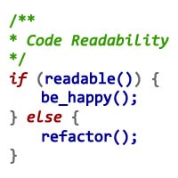
Why Do We Need Methods?
Methods are important in software development
Reduce complexity
Divide and conquer
Complex problems are split into composition of smaller problems
Improve code readability
Small methods with good method names make the code self-documenting
Avoid duplicating code
Duplicating code is hard to maintain

Slide 46

Using Methods
A method should do exactly what its name says
In case of incorrect input or incorrect preconditions
An error should be returned (e.g. throw exception)
No side effects
int Sum(int[] elements)
{
int sum = 0;
foreach (int element in elements)
{
sum = sum + element;
}
return sum;
}
long Sum(int[] elements)
{
long sum = 0;
foreach (int element in elements)
{
sum = sum + element;
}
return sum;
}
What will happen if we sum 2,000,000,000 + 2,000,000,000
Works correctly in all possible scenarios
Result: -294967296

Slide 47

Strong Cohesion
Cohesion is the degree to which the elements inside a module belong together
A module with high cohesion contains elements that are tightly related to each other
A module is said to have low cohesion if it contains unrelated elements
Methods should have strong cohesion

Slide 48
Strong Cohesion in Methods – Example
Methods should have strong cohesion
Should address single task and address it well
Should have clear intent
Methods that address several tasks in the same time are hard to be named
Performs a different operation depending on an input parameter
No external dependencies or side effects
object ReadAll(int operationCode)
{
if (operationCode == 1) … // Read person name
else if (operationCode == 2) … // Read address
else if (operationCode == 3) …
// Read date
…
}
Math.Sqrt(value) → square root
char.IsLetterOrDigit(ch)
string.Substring(str, startIndex, length)
Method performs certain well-defined calculation and returns a single result

Slide 49
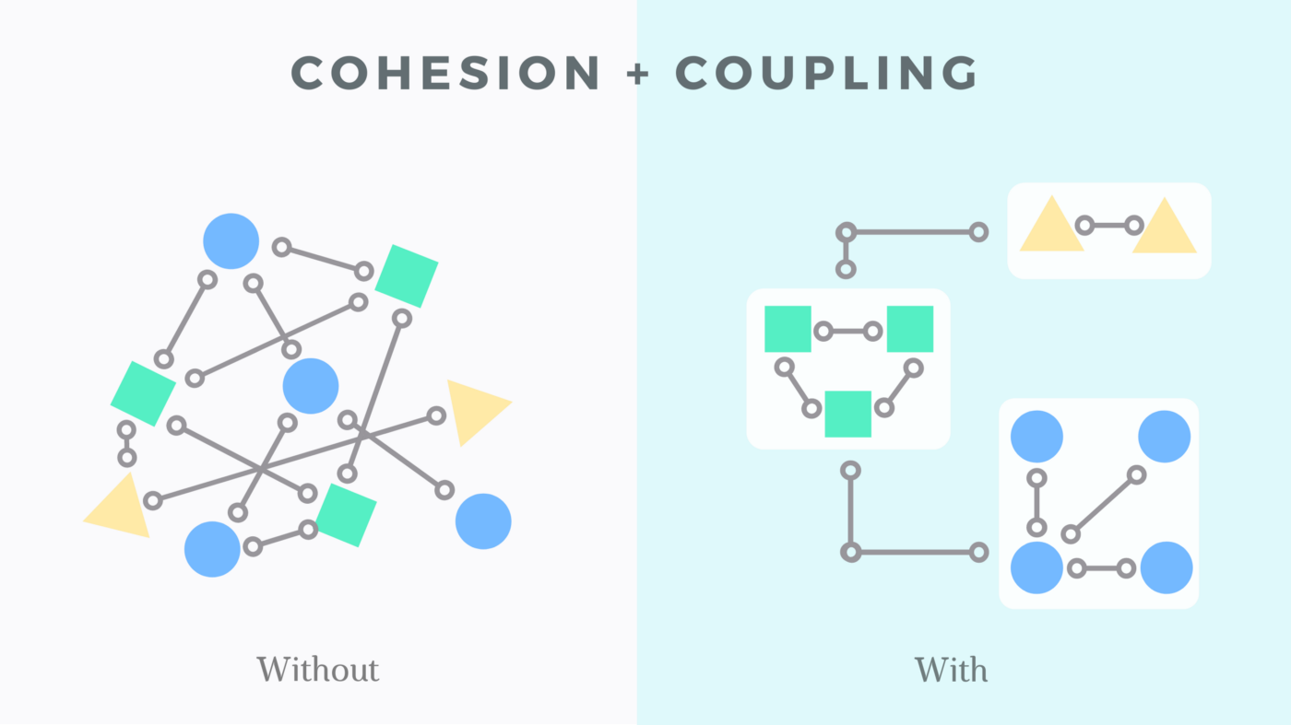
Loose Coupling
Coupling is the degree of interdependence between software modules
Loose coupling refers to the connection between components
Provide flexibility
More adaptable
Tight coupling → spaghetti code
Strong cohesion correlates with loose coupling

Slide 50
Loose Coupling – Examples
Passing parameters through class fields, typical example of tight coupling
Hide the complex logic
byte[] EncryptAES
(byte[] inputData, byte[] secretKey)
{
MemoryStream inputStream = new MemoryStream(inputData);
MemoryStream outputStream = new MemoryStream();
EncryptionUtils.EncryptAES(
inputStream, outputStream, secretKey);
byte[] encryptedData = outputStream.ToArray();
return encryptedData;
}
class Sumator
{
public int a, b;
int Sum()
{
return a + b;
}
static void Main()
{
Sumator sumator =
new Sumator() { a = 3, b = 5 };
Console.WriteLine(sumator.Sum());
}
}
Provides simple straightforward interface
Don't do this unless you have a good reason!
To reduce coupling we can make utility classes
50

Slide 51
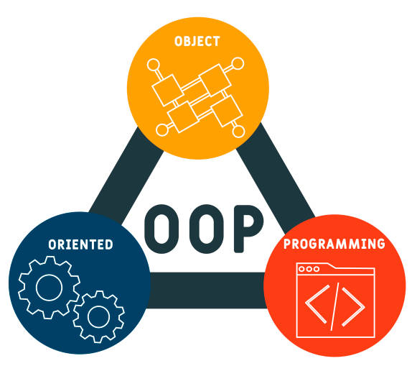
High-Quality Classes
Best Practices in Object-Oriented Design

Slide 52
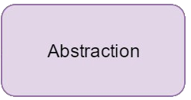
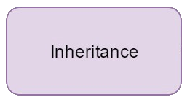
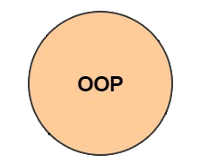
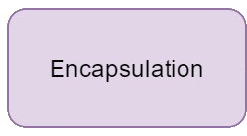
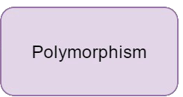
High-Quality Classes
When creating quality classes, the main rules stem from the four main OOP principles

Slide 53
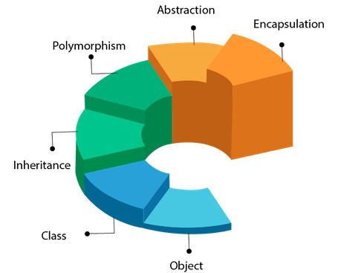
OOP Principles
Abstraction
Abstraction is to represent the essential feature without representing the background details
Encapsulation
Wrapping up a data member and a method together into a single unit
Inheritance
When a class includes a property of another class it is known as inheritance
Polymorphism
Polymorphism means one name, many forms, one function behaves in different forms

Slide 54
Abstraction and Encapsulation – Examples
Encapsulation by using property
Object Mobile Phone
public class Department
{
private string departName;
public Department(string departName)
{
this.DepartName = departName;
}
public string DepartName
{
get
{
return departName;
}
set
{
departName = value;
}
}
}
abstract class MobilePhone
{
public abstract void Calling();
public abstract void SendSMS();
}
public class Nokia2700: MobilePhone
{
public void FMRadio();
public void MP3();
public void Camera();
}
public class BlackBerry: MobilePhone {
public void FMRadio();
public void MP3();
public void Camera();
public void Recording();
public void ReadAndSendEmails();
}
2 more objects that inherit from the Mobile Phone
2 more objects that inherit from the Mobile Phone
get accessor returns the value of the property field
The property has two accessor get and set
Abstract information (necessary and common information) for the object "Mobile Phone"
set accessor sets the value of the property field

Slide 55
Polymorphism and Inheritance – Examples
One name, many forms: polymorphism
Process of object reusability: inheritance
class Animal
{
public virtual void AnimalSound()
{
Console.WriteLine("The animal makes a sound");
}
}
class Pig : Animal
{
public override void AnimalSound()
{
Console.WriteLine("The pig says: wee wee");
}
}
class Dog : Animal
{
public override void AnimalSound()
{
Console.WriteLine("The dog says: bow wow");
}
}
The Animal class has a virtual method
The Pig class includes the properties and methods of the parent class Animal
The Pig and Dog classes inherit the Animal class and can override it's virtual method
The Pig and Dog classes inherit the Animal class and can override it's virtual method
The Dog class includes the properties and methods of the parent class Animal
Many forms of a single object

Slide 56

High-Quality Methods and Classes
Live Demo

Slide 57

Refactoring
When and How to Refactor?

Slide 58
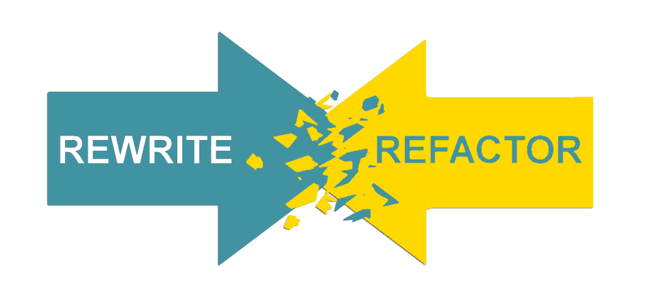
What is Code Refactoring?
A step by step process that turns the bad code into good code
Without changing its external behavior
Based on "refactoring patterns" → well-known recipes for improving the code
Why we need refactoring?
Code constantly changes and its quality constantly degrades
Requirements often change and code needs to be changed to follow them

Slide 59
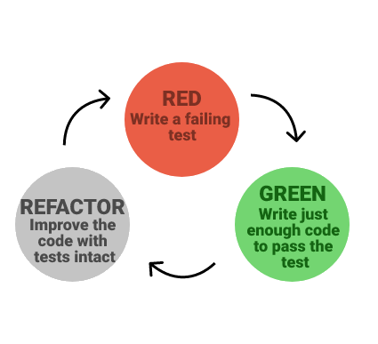
When to Refactor?
Bad smells in the code indicate need of refactoring
Refactor:
To make adding a new function easier
As part of the process of fixing bugs
When reviewing someone else's code
Have technical debt (or any problematic code)
When doing test-driven development
Unit tests guarantee that refactoring does not change the behavior

Slide 60
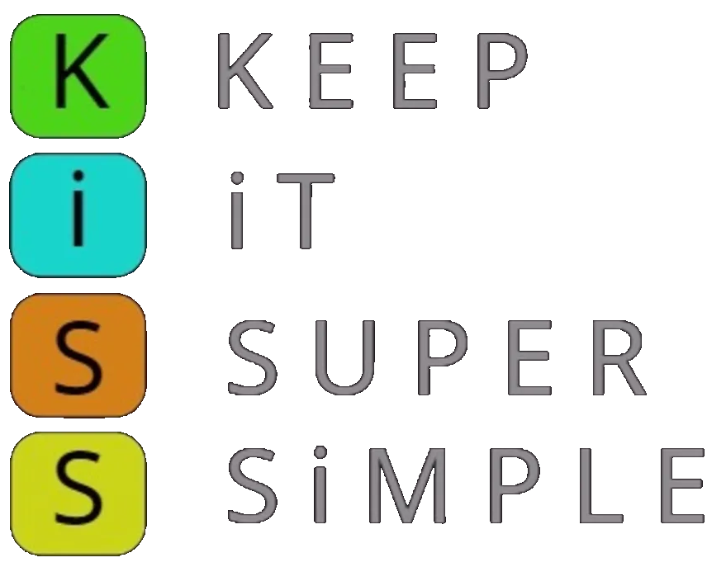

Refactoring: Main Principles
Keep it simple (KISS principle)
Avoid duplication (DRY principle)
Make it expressive (self-documenting, comments, etc.)
Reduce overall code (KISS principle)
Separate concerns (decoupling)
Appropriate level of abstraction (work through abstractions)
Boy scout rule
Leave your code better than you found it

Slide 61
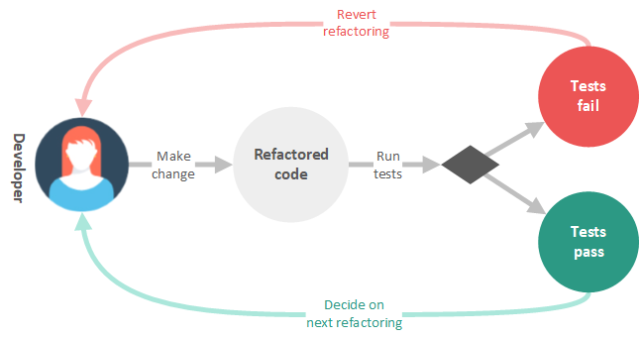
Refactoring: The Typical Process
Save the code you start with
Check-in or backup the current code
Prepare tests to assure the behavior after the code is refactored
Unit tests / characterization tests
Do refactoring one at a time
Keep refactoring small
Don't underestimate small changes
Run the tests and they should pass / else revert
Check-in (into the source control system)

Slide 62

Refactoring Patterns
Well-Known Recipes for Improving the Code Quality

Slide 63

Refactoring Patterns
Large repeating code fragments → extract duplicated code in separate method
Large methods → split them logically
Large loop body or deep nesting → extract method
Class or method has weak cohesion → split into several classes / methods
A method has too many parameters → create a class to groups parameters together
A method calls more methods from another class than from its own class → move it

Slide 64
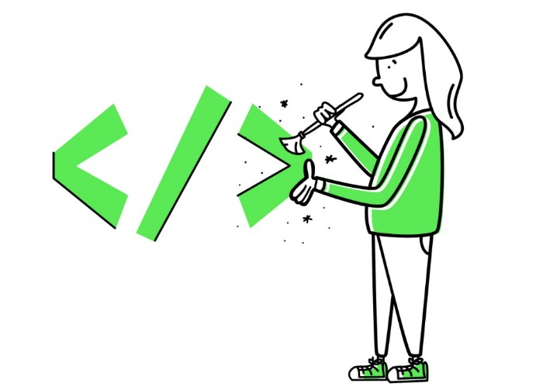
Refactoring Patterns (2)
Two classes are tightly coupled → merge them or redesign them to separate their responsibilities
Magic numbers in the code → consider extracting constants
Bad named class / method / variable → rename it
Complex Boolean condition → split it to several expressions or method calls
Complex expression → split it into few simple parts
Too complex method logic → extract several more simple methods or even create a new class
Unused classes, methods, parameters, variables → remove them

Slide 65

Refactoring Levels
Data, Statement, Method and Class Levels

Slide 66
Data-Level Refactoring – Bad Example
Badly initialized variables
int[] nums = new int[10];
int sum = 0, avg = 0, low = 0, high = 0;
for (int i = 0; i < 10; i++)
{
Console.Write($"Number {i + 1}: ");
nums[i] = int.Parse(Console.ReadLine());
sum += nums[i];
}
avg = sum / 10;
for (int i = 0; i < 10; i++)
{
if (nums[i] < avg)
{
low++;
}
else
{
high++;
}
}
Convert a set of type codes (constants) to enum
Rename a variable with more informative name
Convert a data primitive to a class
Replace a magic number with a named constant
Additional behavior / validation logic (money)
Replace an expression with a method

Slide 67
Data-Level Refactoring – Good Example
No magic numbers
const int ArrayLength = 10;
int sum = 0;
int[] numbers = new int[ArrayLength];
for (int i = 0; i < numbers.Length; i++)
{
Console.Write($"Number {i + 1}: ");
numbers[i] = int.Parse(Console.ReadLine());
sum += numbers[i];
}
int average = sum / numbers.Length;
int lowerThanAverage = 0;
int higherThanAverage = 0;
SeparateLowerAndHigherNumbersThanAverageValue
(lowerThanAverage, higherThanAverage, numbers, average);
Good variable names
The previous part has been replaced by a method

Slide 68
Statement-Level Refactoring – Bad Example
if (date < SUMMER_START || date > SUMMER_END)
{
charge = quantity * winterRate + winterServiceCharge;
}
else
{
charge = quantity * summerRate;
}
Move a complex Boolean expression into a well-named Boolean function
Use break or return instead of a loop control variable
string DailyGreetings(int dayTime)
{
string greeting = "";
if (dayTime <= 8)
{
greeting = "Good Morning";
}
if (dayTime >= 12)
{
greeting = "Good Afternoon";
}
…
return greeting;
}
Replace conditionals with polymorphism
Consolidate duplicated code in conditionals
Return as soon as you know the answer instead of assigning a return value
Use null-object design pattern instead of checking for null

Slide 69
Statement-Level Refactoring – Good Example
if (isSummer(date))
{
charge = SummerCharge(quantity);
}
else
{
charge = WinterCharge(quantity);
}
Decompose the complicated parts of the conditional into separate methods
string DailyGreetings(int dayTime)
{
if (dayTime <= 8)
{
return "Good Morning";
}
if (dayTime >= 12)
{
return "Good Afternoon";
}
...
return "Good Nigth";
}
Return as soon as you know the answer
Return as soon as you know the answer

Slide 70
Method-Level Refactoring – Bad Example
void PrtOwn()
{
this.PrintBanner();
Console.WriteLine("name: " + this.Name);
Console.WriteLine("amount: " + this.GetAmount());
}
Rename a method
Extract method / inline method
Convert a long routine to a class
string FoundPerson(string[] people)
{
for (int i = 0; i < people.Length; i++)
{
if (people[i].Equals("Don"))
{
return "Don";
}
if (people[i].Equals("John"))
{
return "John";
}
}
return "Not Found";
}
Add / remove parameter
Combine similar methods by parameterizing them
Substitute a complex algorithm with simpler
Separate methods whose behavior depends on parameters passed in (create new ones)
Pass a whole object rather than specific fields
Encapsulate downcast / return interface types

Slide 71
Method-Level Refactoring – Good Example
A better name
void PrintOwing()
{
this.PrintBanner();
this.PrintDetails();
}
void PrintDetails()
{
Console.WriteLine("name: " + this.Name);
Console.WriteLine("amount: " + this.GetAmount());
}
Extracted method
string FoundPerson(string[] people, string[] candidates)
{
for (int i = 0; i < people.Length; i++)
{
if (candidates.Contains(people[i]))
{
return people[i];
}
}
return "Not Found";
}
Added a new parameter
Simplified algorithm

Slide 72
Class-Level Refactoring – Bad Example
public class LocalCourse : Course, ILocalCourse
{
public string Lab { get; set; }
public override string ToString()
{
StringBuilder sb = new StringBuilder();
sb.Append(this.GetType().Name);
sb.AppendFormat("(Name={0}", this.Name);
if (!(this.Teacher == null))
sb.AppendFormat("; Teacher={0}", this.Teacher.Name);
sb.AppendFormat("; Lab={0})", this.Lab);
return sb.ToString();
}
}
public class OffsiteCourse : Course, ILocalCourse
{
public string Town { get; set; }
public override string ToString()
{
StringBuilder sb = new StringBuilder();
sb.Append(this.GetType().Name);
sb.AppendFormat("(Name={0}", this.Name);
if (!(this.Teacher == null))
sb.AppendFormat("; Teacher={0}", this.Teacher.Name);
sb.AppendFormat("; Town={0})", this.Town);
return sb.ToString();
}
}
Change a structure to class and vice versa
Repeating code
Pull members up / push members down the hierarchy
Extract specialized code into a subclass
Combine similar code into a superclass
Repeating code
Collapse hierarchy
Replace inheritance with delegation
Replace delegation with inheritance

Slide 73
Class-Level Refactoring – Good Example
public class LocalCourse : Course, ILocalCourse
{
public string Lab { get; set; }
public override string ToString()
{
return base.ToString() + "; Lab=" + this.Lab + ")";
}
}
public class OffsiteCourse : Course, ILocalCourse
{
public string Town { get; set; }
public override string ToString()
{
return base.ToString() + "; Town=" + this.Town + ")";
}
}
When overriding methods, call the base method if you need its functionality, don't copy-paste it!

Slide 74
Summary
High quality code –correct, readable and maintainable
Meaningful names (according to the context), single purpose
Formatting – blocks, types, method parameters, separating logically related blocks of code + writing self-documented code
Use variables to show the intent of your code, keep expressions simple, use constants to avoid "magic" values
Quality methods – no single solution, choose the most appropriate solution, try to be flexible
Quality classes – use OOP principles, strong cohesion, loose coupling
Refactoring is making bad code good by not changing its behavior

Slide 75
Questions?

Slide 76

License
This course (slides, examples, code, demos, exercises, tutorials, homework, projects, documents, videos and other assets) is copyrighted content, created by SoftUni
Unauthorized copy, reproduction or use is illegal
© SoftUni – https://softuni.org
© Software University – https://softuni.bg

Slide 77




Trainings @ Software University (SoftUni)
Software University – High-Quality Education, Profession and Job for Software Developers
softuni.bg
Software University Foundation
https://softuni.foundation
Software University @ Facebook
facebook.com/SoftwareUniversity
Software University Forums
forum.softuni.bg

